Slide 1

GROUP PROJECT
ME361
PROJECT 17
Reverse Engineering of FREE FORM COMPONENT
Group B2

Slide 2
OUR TEAM
Roll No | Name | Contribution
220263 | Ayush Dwivedi | CAD Model
220287 | Bhagat Gaurang Mahendrabhai | Presentation
220307 | Chauhan Rohit Naresh | Minor
220314 | Chirag Meena | Presentation
220319 | Dabbe Kunal Suresh | Reading
220320 | Dagani Keerthana | Minor
220333 | Deepavath Raghu Ram Naik | Grid Lines
220343 | Devansh Chaudhary | CAD Model
220349 | Devraj Mathur | Software files
220353 | Dharmendra Jangir | Presentation

Slide 3
OBJECTIVE
The objective of this experiment is to reverse engineer a free-form component by measuring its precise coordinates using a Coordinate Measuring Machine (CMM) and converting these measurements into a detailed 3D model. The process involves capturing accurate coordinate data from various points on the component's surface, then using specialized software (like CATIA and SolidWorks) to transform these coordinates into a digital representation of the component's geometry. This approach will enable the reconstruction of the component's original design.

Slide 4
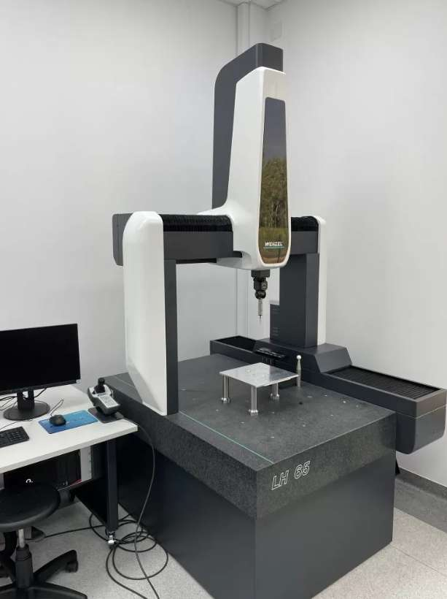
APPARATUS REQUIRED
CMM
Mouse
Reference Stand
CAD Software (Fusion 360)

Slide 5

Designing of computer mouse
For our project we decided to make a mouse using reverse engineering with CMM.
So, we used Logitech G102 mouse for this purpose.

Slide 6

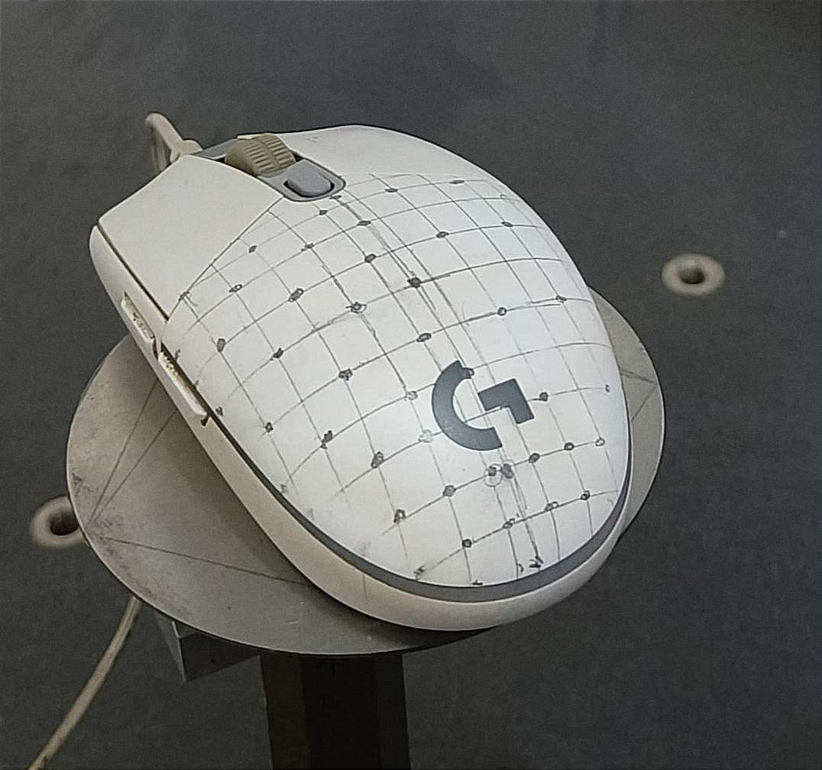
Techniques Used to measure THE DIMENSIONS
We first decided where to place origin on mouse.
As CMM measures points, there was a need to get a well-defined point system on the mouse.
We started drawing grids on mouse for this purpose.
Then using CMM we measured the coordinates of corner points of grid.
MOUSE PHOTO WITH GRID LINES

Slide 7
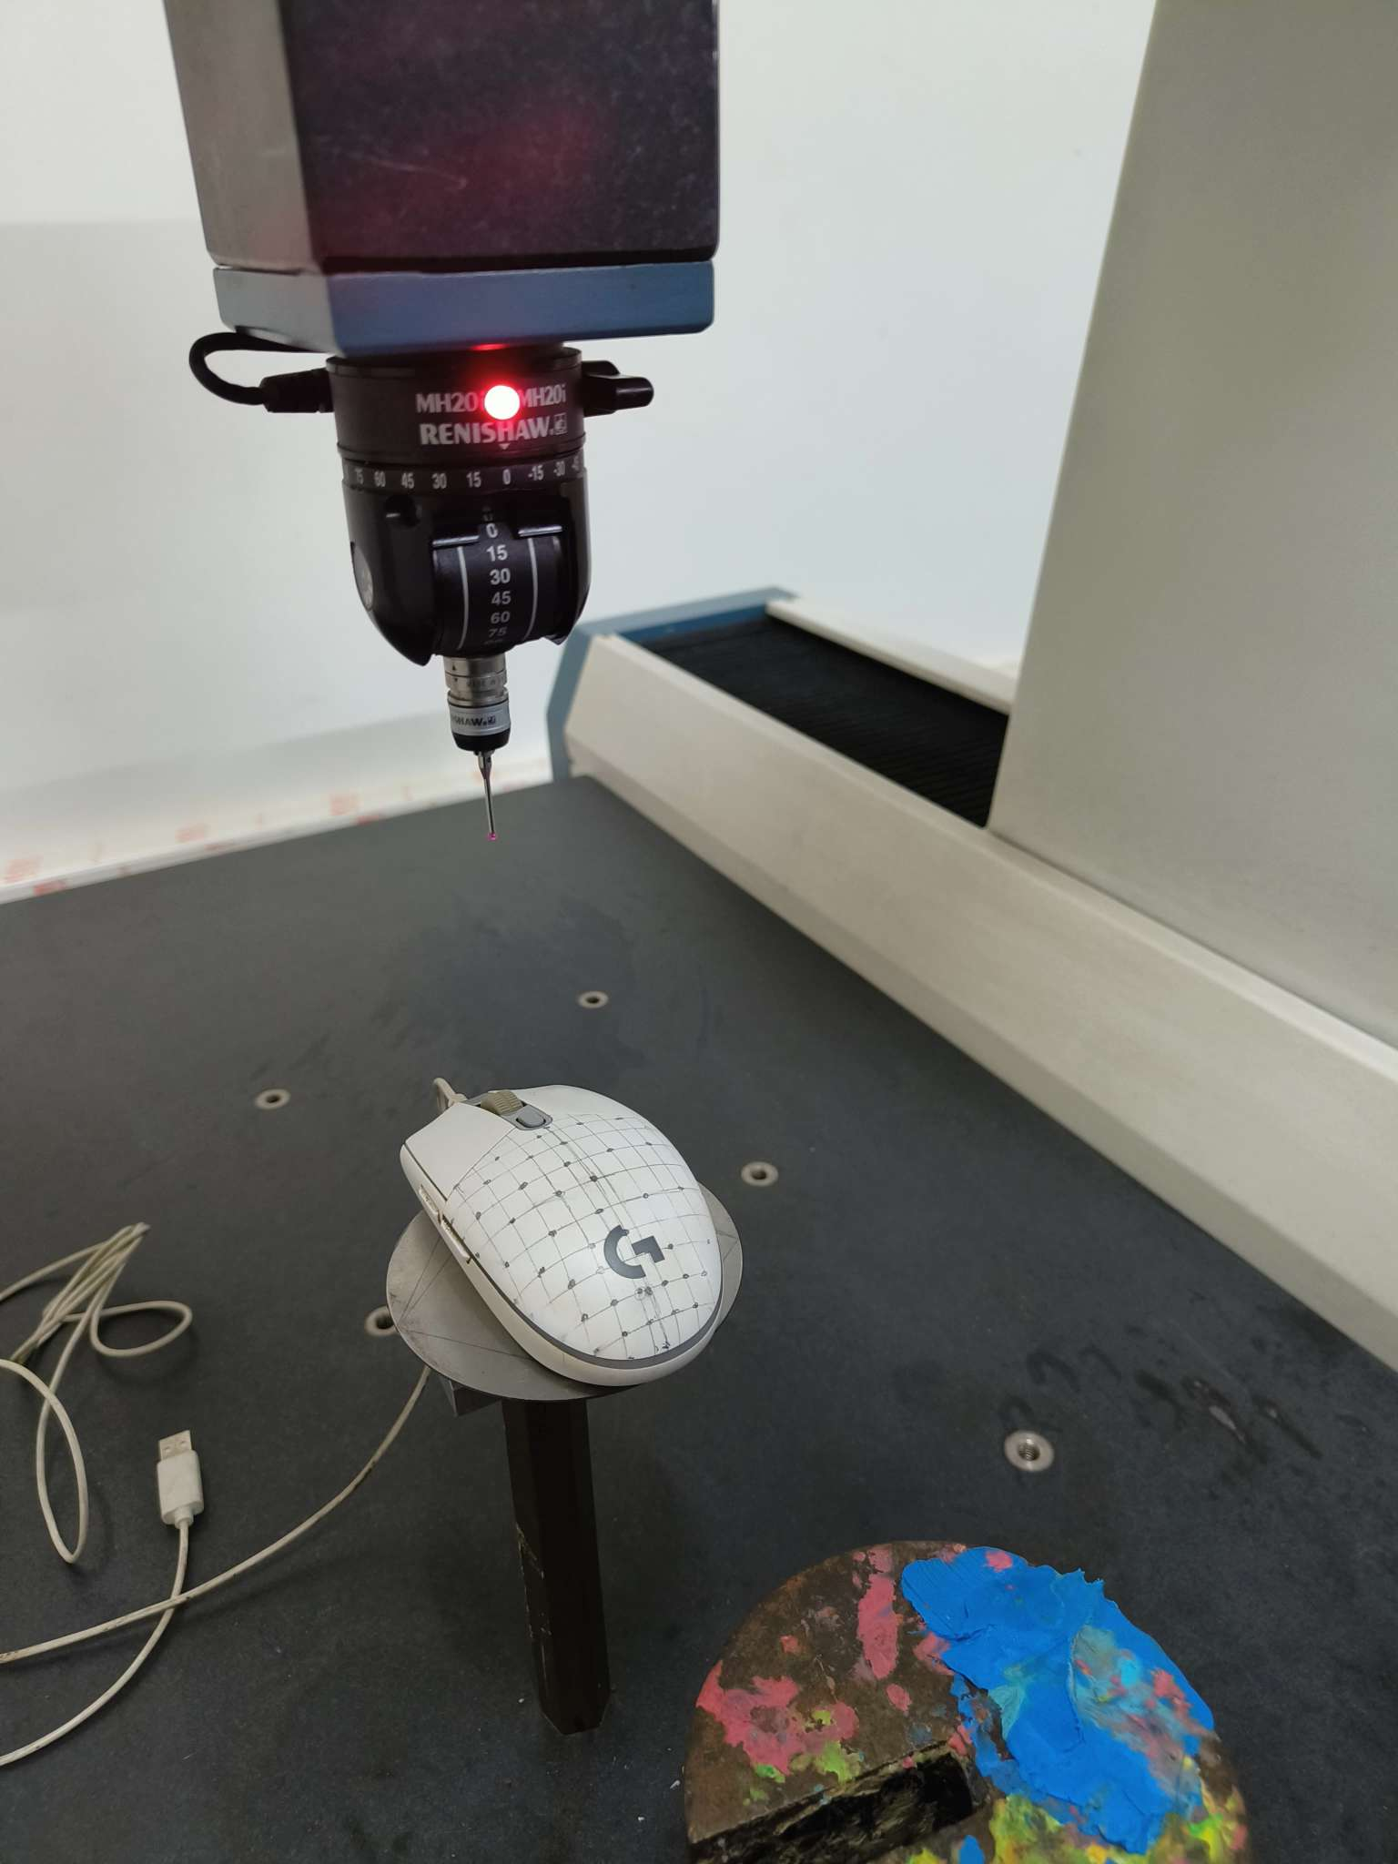
Operating CMM
First, we started CMM and open Tangram software.
We set the mouse on measuring bed in a configuration which would minimize the effort of measuring the points using probe controller.(As shown in figure.)
After that we took the reading of decided origin and then calibrated it as system origin.

Slide 8
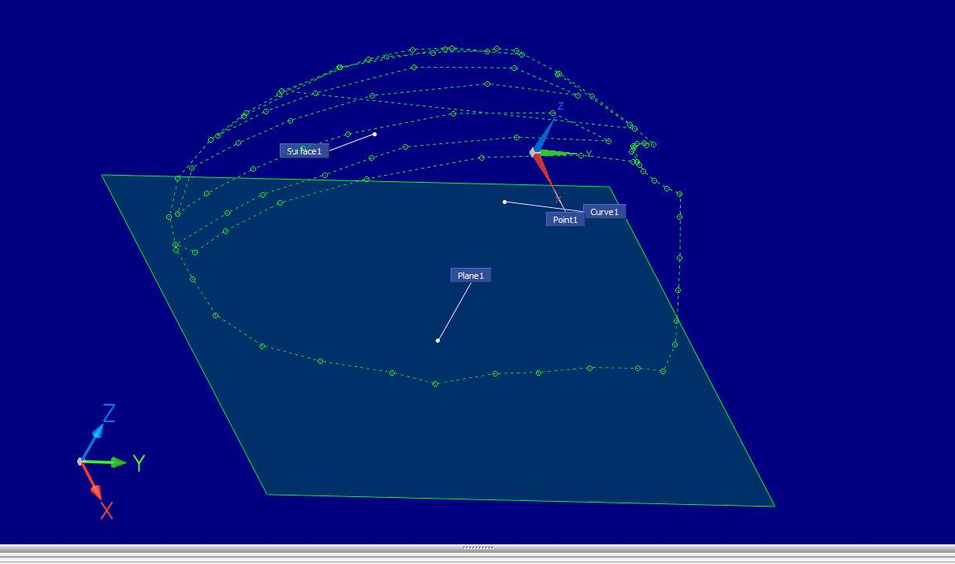
Measuring points on cmm
First, we begin to measure border of backside of top surface using curve function in software.
Then we selected surface option from the software and started recording the points inside the border measured above for half portion (As there is symmetry on mouse and due to malfunction of the CMM machine.)

Slide 9

REASON FOR NOT COMPLETING THE MOUSE
At the time of measuring points, the machine was unable to measure more than 40 points, and after this, the machine crashed, and we had to restart the machine and work. So it took a longer time to develop a single surface.
In the next lab, the lab technician told me that the machine was broken and couldn’t be used now.

Slide 10

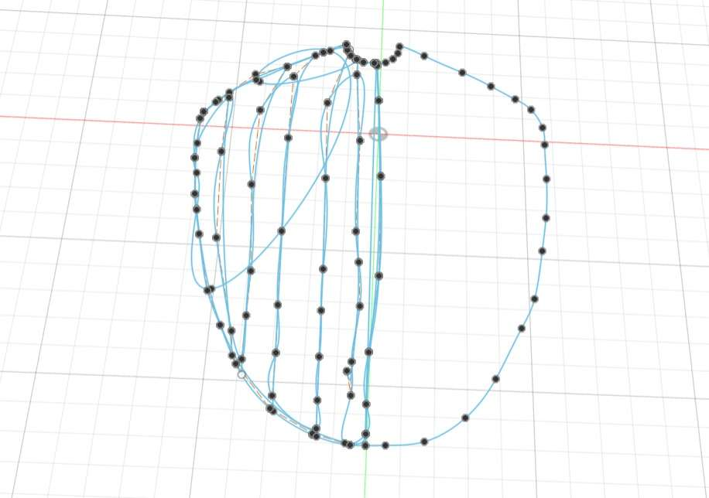
REASON FOR NOT COMPLETING FULL MOUSE
The unavailability of software tools such as CATIA, Siemens NX (with Reverse Engineering Module), and Geo-Magic Design X prevented us from converting the CMM coordinates into a CAD model directly, which was essential for completing the experiment.
Due to this reason, it was very hard to patch these points to form surfaces in FUSION 360, and hence we had to add extra points manually to patch up the surface.

Slide 11
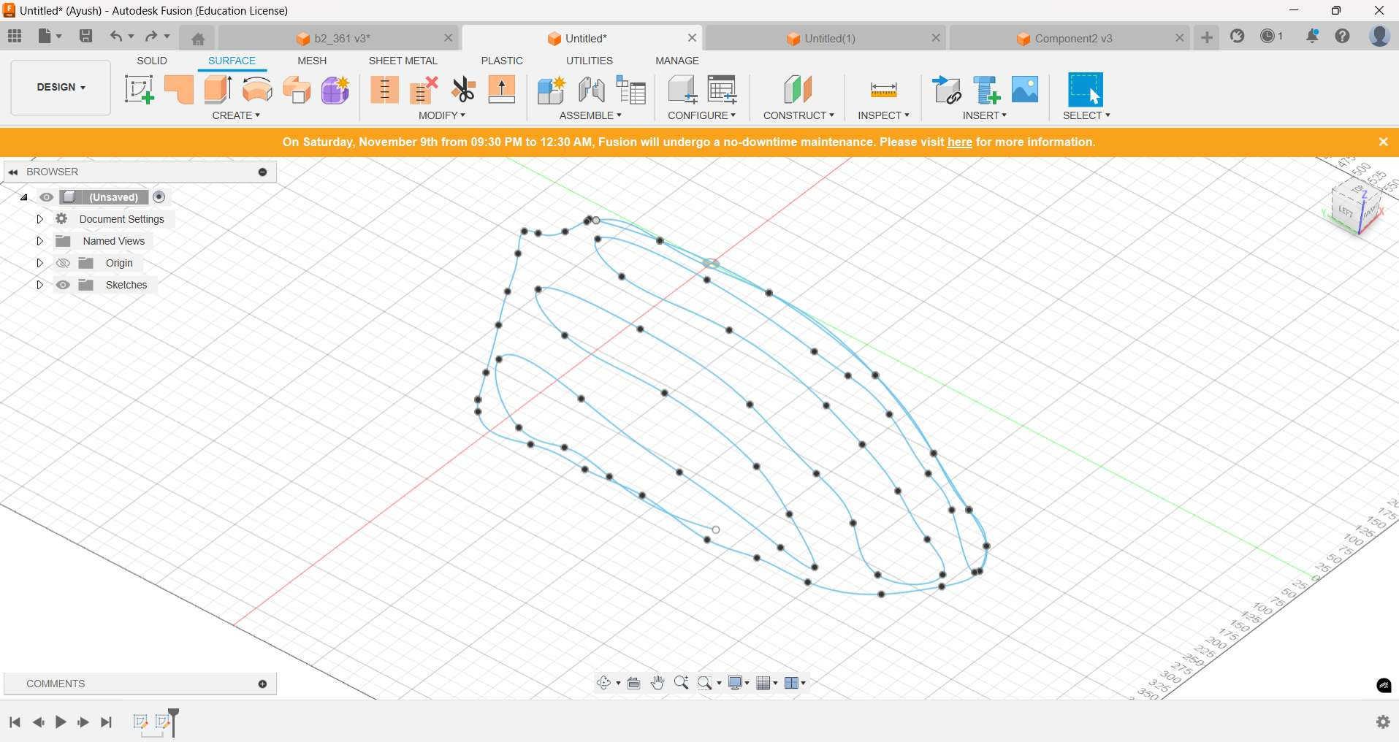
WORKING ON FUSION 360
Digital processing of the raw data obtained from the CMM measurements in the form of 3D coordinates in an Excel file to obtain a CAD model using Fusion 360
Then we converted the excel file to a csv file and imported the points in the form of a spline curve using the import spline curves csv option.
See figure for imported geometry in Fusion 360.

Slide 12
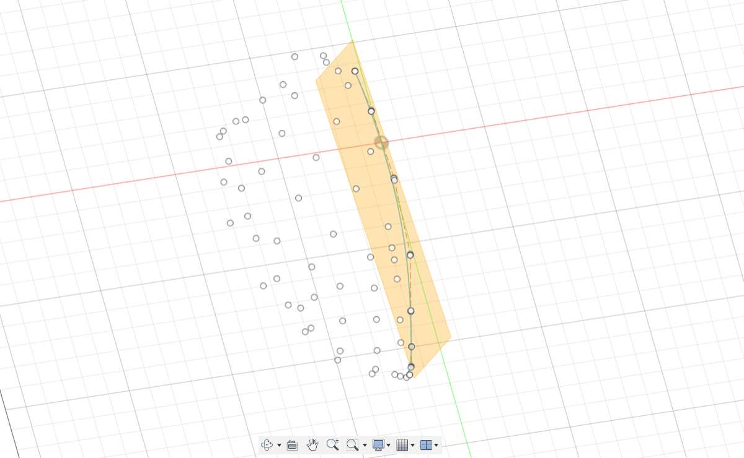
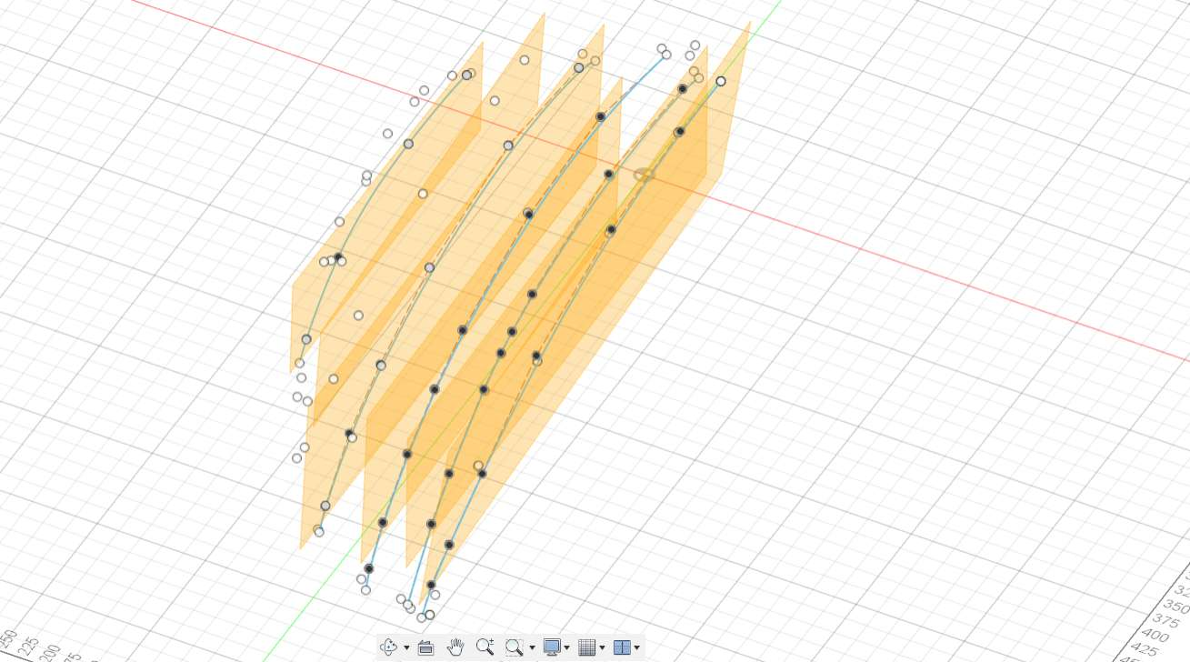
WORKING ON FUSION 360
Then we modified geometry by drawing parallel curves in different planes along the surface through available coordinate points to use patch function and form a smooth surface.

Slide 13
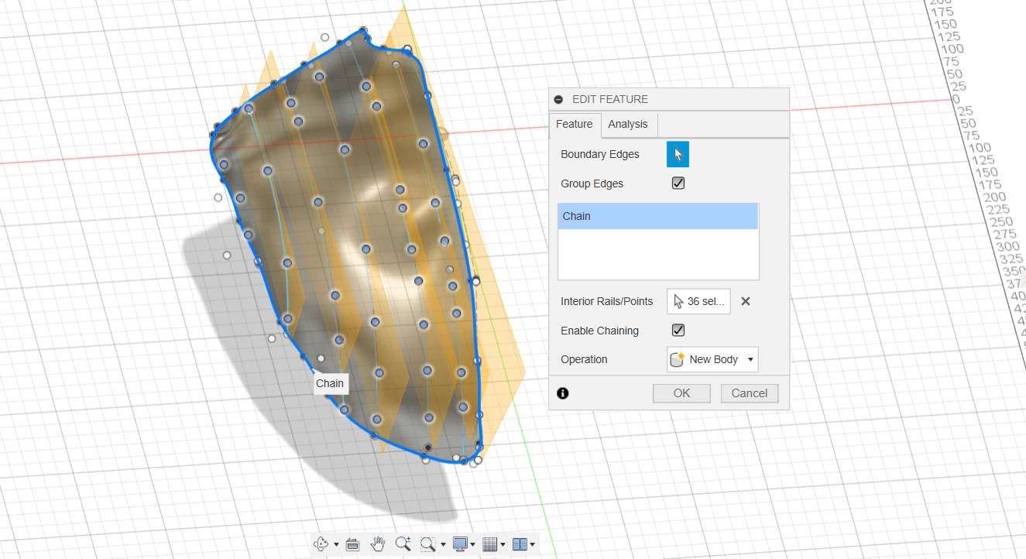
WORKING ON FUSION 360
Then we used the patch feature and selected boundary edges and interior rails to guide the free form surface.

Slide 14
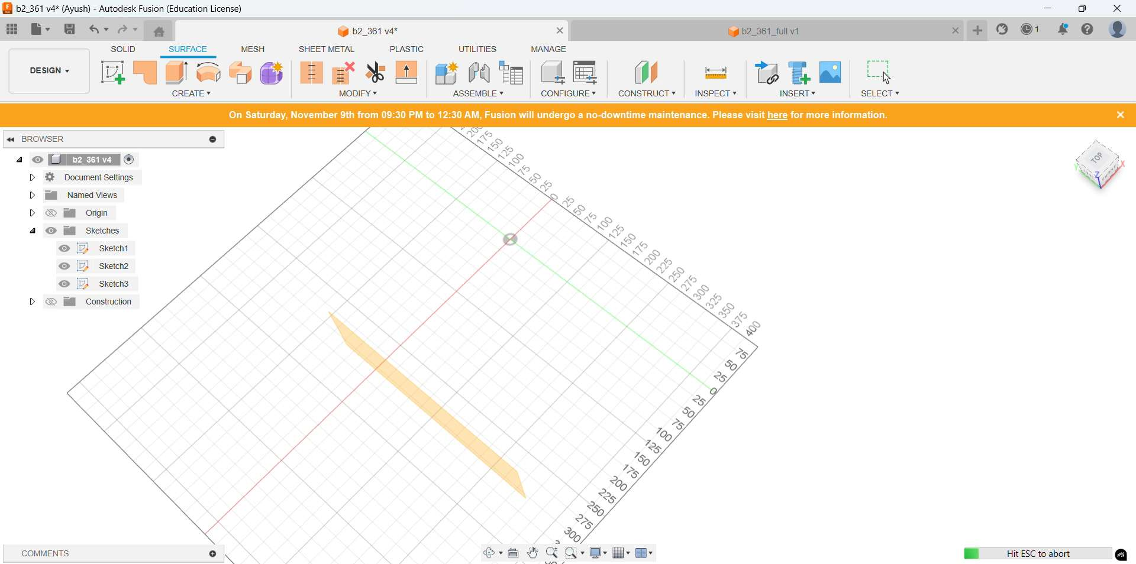
WORKING ON FUSION 360

Slide 15
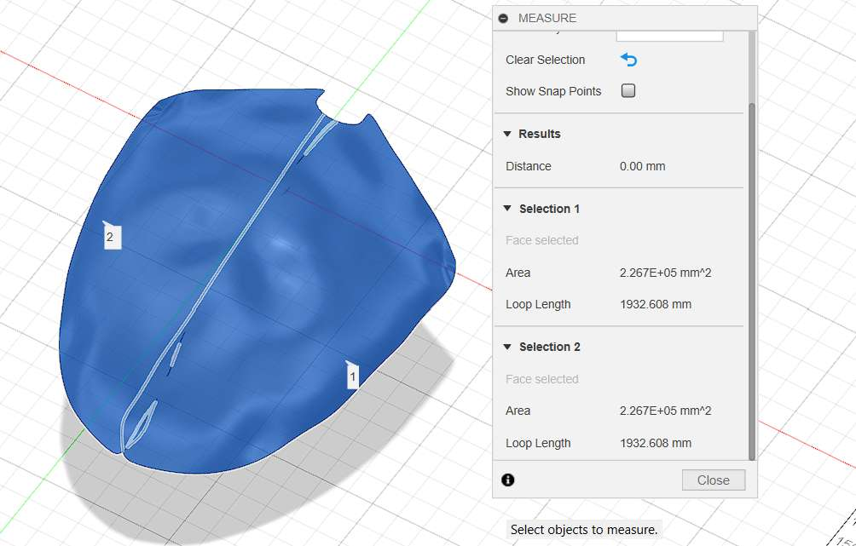
Expectation and Actual result
Surface area of the CAD model is approximately equal to 4.52 E+05 mm2.

Slide 16
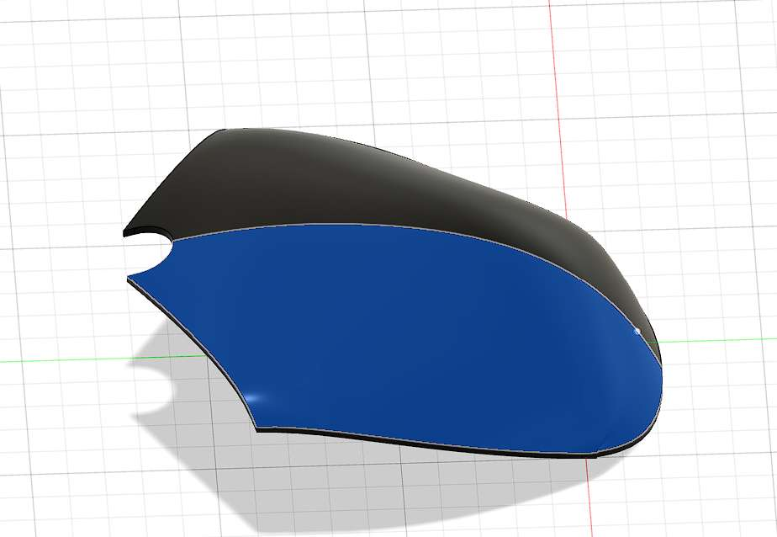
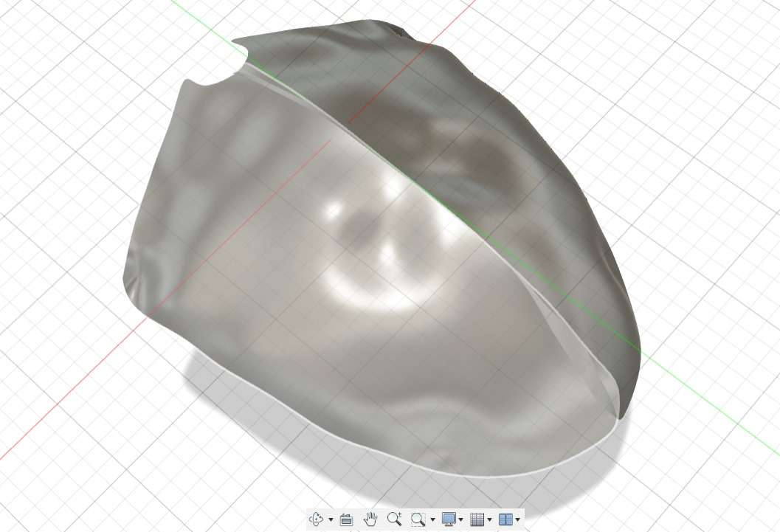
Expectation and Actual result

